Slide 1



DESIGN OF ENERGY HARVESTING ANTENNA USING OPTIMISED TECHNIQUE
PROJECT REVIEW 2
PRESENTED BY:
GUIDED BY:
S.NAVEEN KUMAR(927621BEC135)
S.NIKESH(927621BEC137)
S.SANTHAKUMAR(927621BEC181)
K.SARANKUMAR(927621BEC185)
DR.V.MARISELVAM

Slide 2
Introduction
Energy harvesting antennas have emerged as a solution to harness excess or leakage energy from electronic and communication components. In this presentation, we introduce a novel approach of attaching antennas to components with high energy leakage.

Slide 3
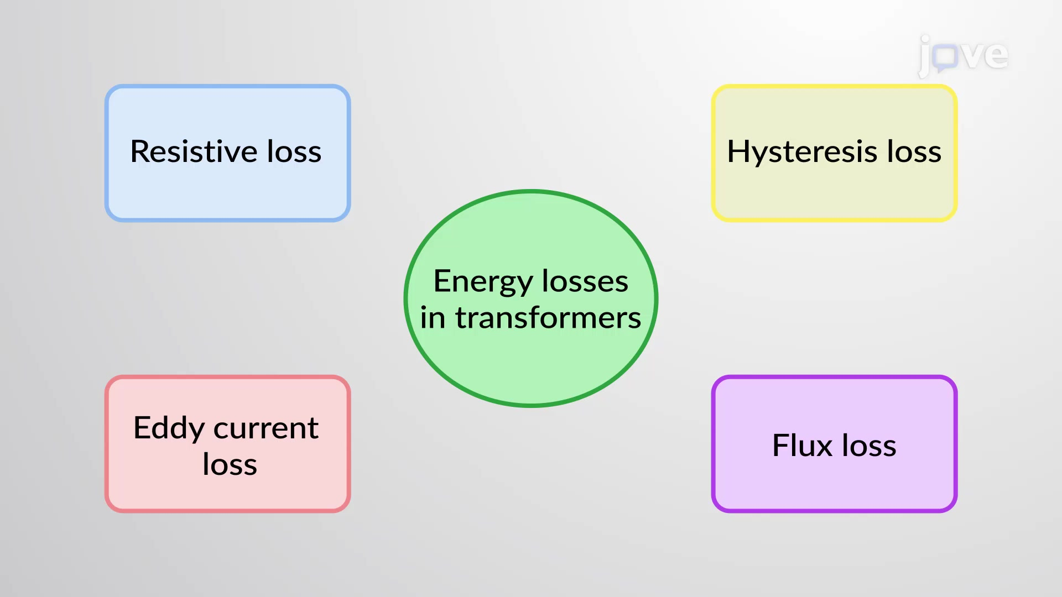
Problem Statement
Traditional energy harvesting methods are not tailored to components with high energy leakage, leading to inefficiencies in energy capture and utilization. There is a need for a specialized approach to address this issue.

Slide 4
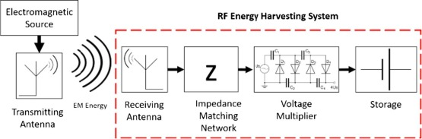
Objectives
The objectives of this presentation are to introduce the concept of energy harvesting antennas, highlight the challenges associated with components with high energy leakage, present our innovative solution, and outline the benefits of our approach.

Slide 5
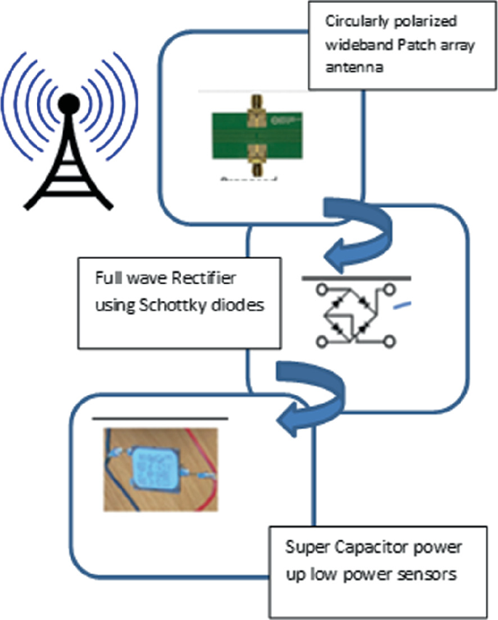
Existing System
Previous energy harvesting antennas often exhibited low gain, limiting their effectiveness in capturing and utilizing ambient energy.
Conventional systems before the advent of energy harvesting antennas relied on methods such as direct power sources, batteries, and wired connections for powering electronic and communication components.

Slide 6
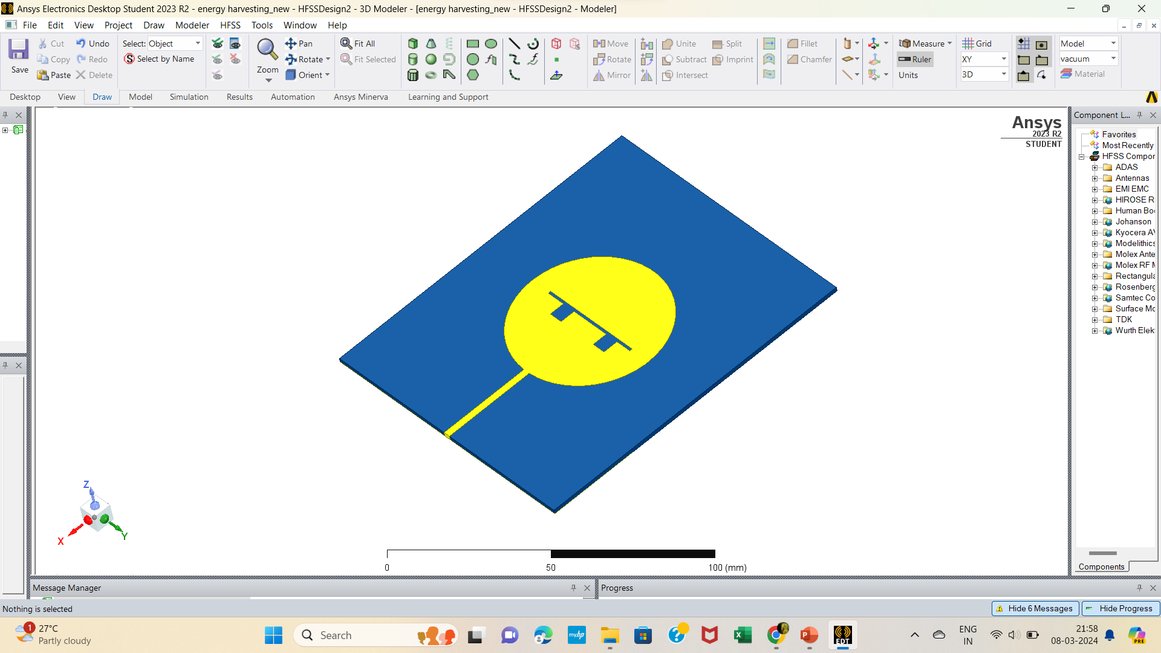
Proposed System
Our proposed system entails attaching energy harvesting antennas directly to components with high energy leakage, thereby capturing and converting this excess energy into usable electrical power for various applications.

Slide 7
Comparison
Increased Deployment Flexibility: Energy harvesting antennas enable the deployment of wireless devices in areas where traditional power sources are unavailable or impractical.
Though these antennas were not specifically designed for higher gain, their response to the input that is the S- parameters are comparable to that of the traditional antennas.

Slide 8
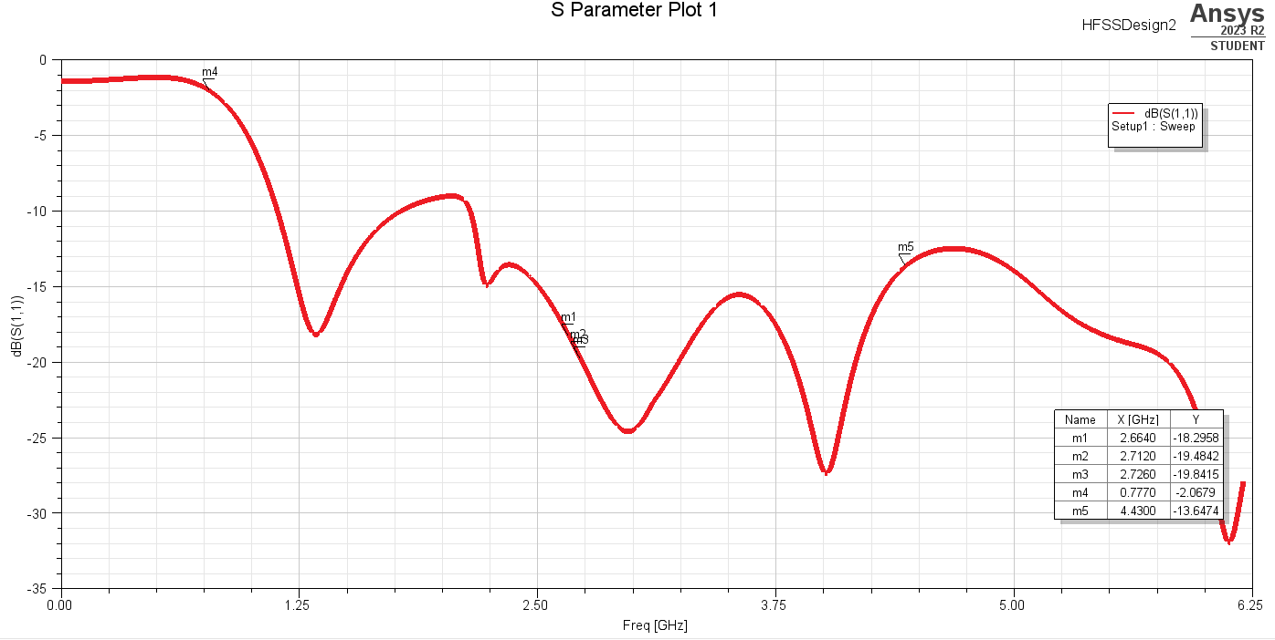
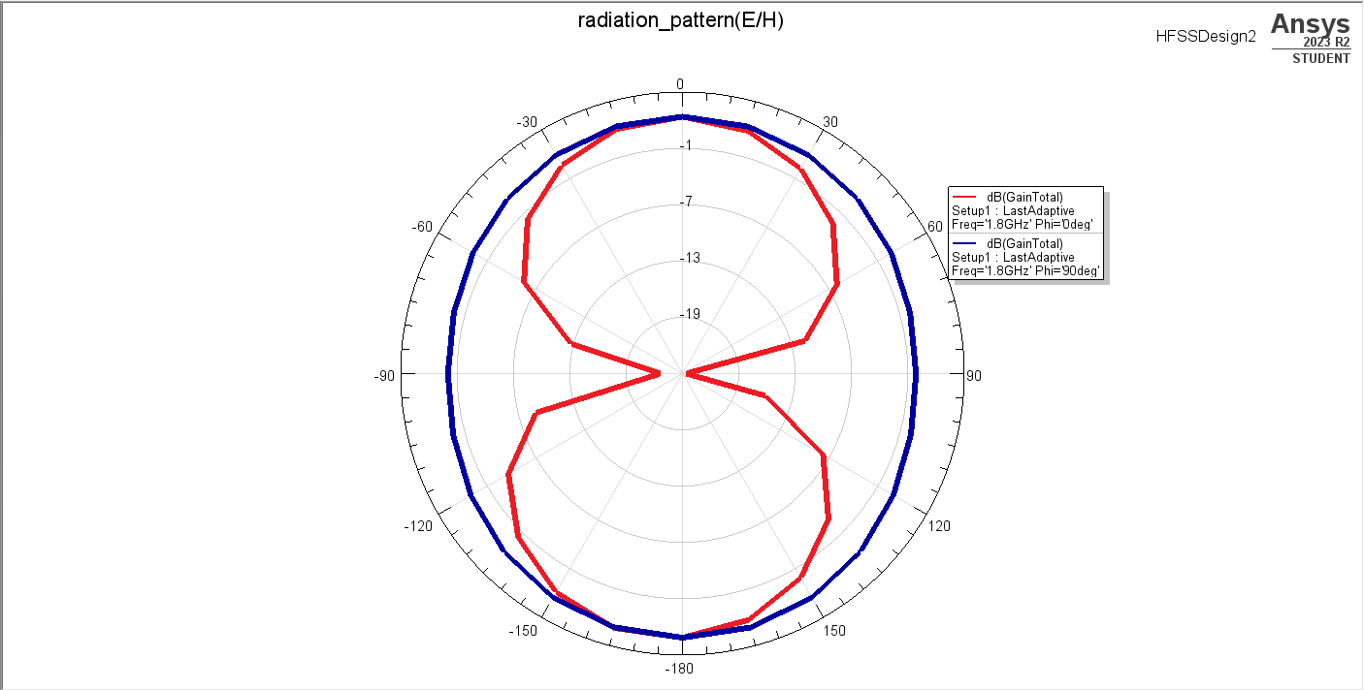
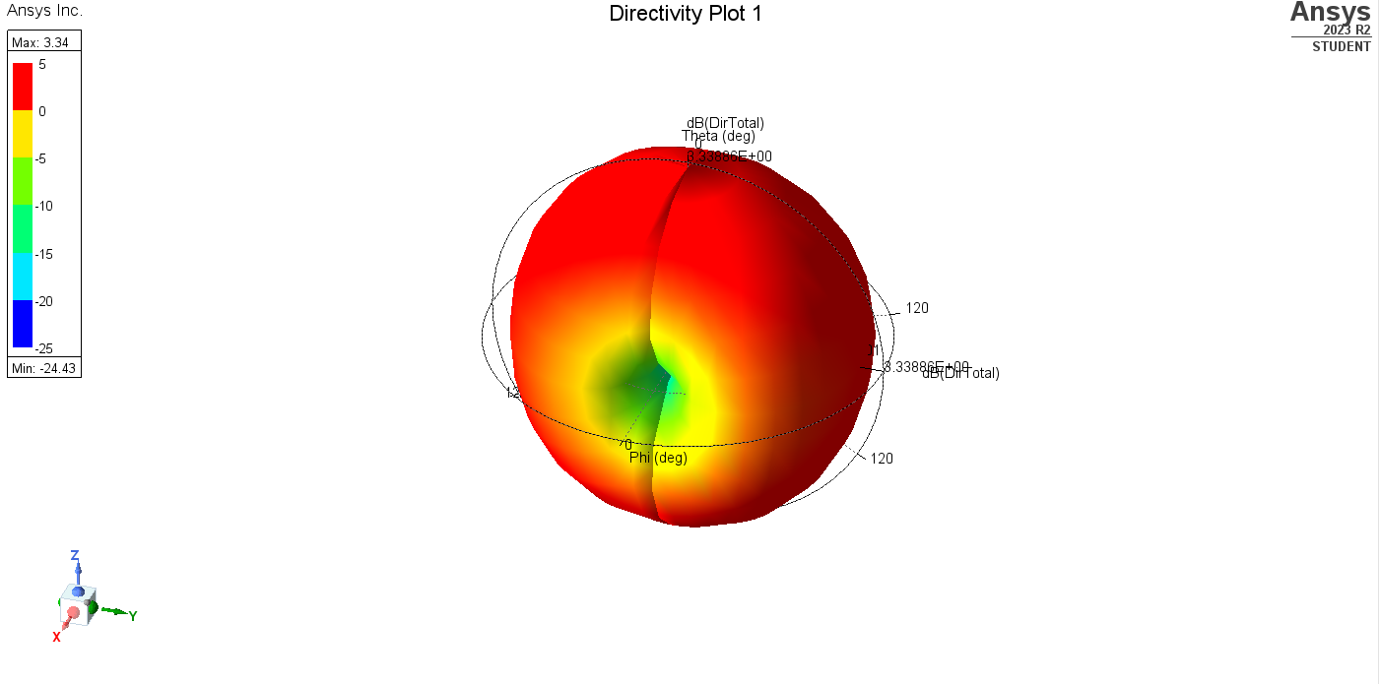
S parameter Gain
Directivity

Slide 9
Conclusion
energy harvesting antennas offer a sustainable and efficient solution for powering wireless devices by converting ambient electromagnetic energy. Their technical advantages, including versatility, efficiency, and adaptability, make them ideal for diverse applications.
As reliance on traditional power sources decreases, energy harvesting antennas emerge as key players in enabling reliable, cost-effective, and environmentally friendly wireless communication and sensing solutions for the future.

Slide 10
REFERENCES
2017 IEEE AP-S Symposium on Antennas and Propagation and USNC-URSI Radio Science Meeting July 9–14, 2017 San Diego, California, USA
M. A. Ullah, R. Keshavarz, M. Abolhasan, J. Lipman, K. P. Esselle and N. Shariati, "A Review on Antenna Technologies for Ambient RF Energy Harvesting and Wireless Power Transfer: Designs, Challenges and Applications," in IEEE Access, vol. 10, pp. 17231-17267, 2022, doi: 10.1109/ACCESS.2022.3149276. keywords: {Radio frequency;Receiving antennas;Energy harvesting;Wireless sensor networks;Sensors;Couplings;Transmitting antennas;Antenna;energy harvesting;IoT;low-power;rectenna;receiving antenna;RFEH;self-powered device;sensors;wireless;WPT;WSN}
Integrated Solar and Radio-Frequency Energy Harvesting for the Internet of Everything Tammy Chang, Jonathan A. Fan, Thomas H. Lee

Slide 11
Thank you.!

